Slide 1
ITP-450: High Performance Computing in Applied Machine Learning
Introduction to Neural Networks
Hao Ji
Data Scientist
Center for Advanced Research Computing
Email: haoji@usc.edu

Slide 2
Outline
Section 1: Introduction to Deep Learning
Section 2: Neural Networks
Section 3: Building Neural Networks with PyTorch
Section 4: Model evaluation & confusion matrix
Section 5: Applications

Slide 3
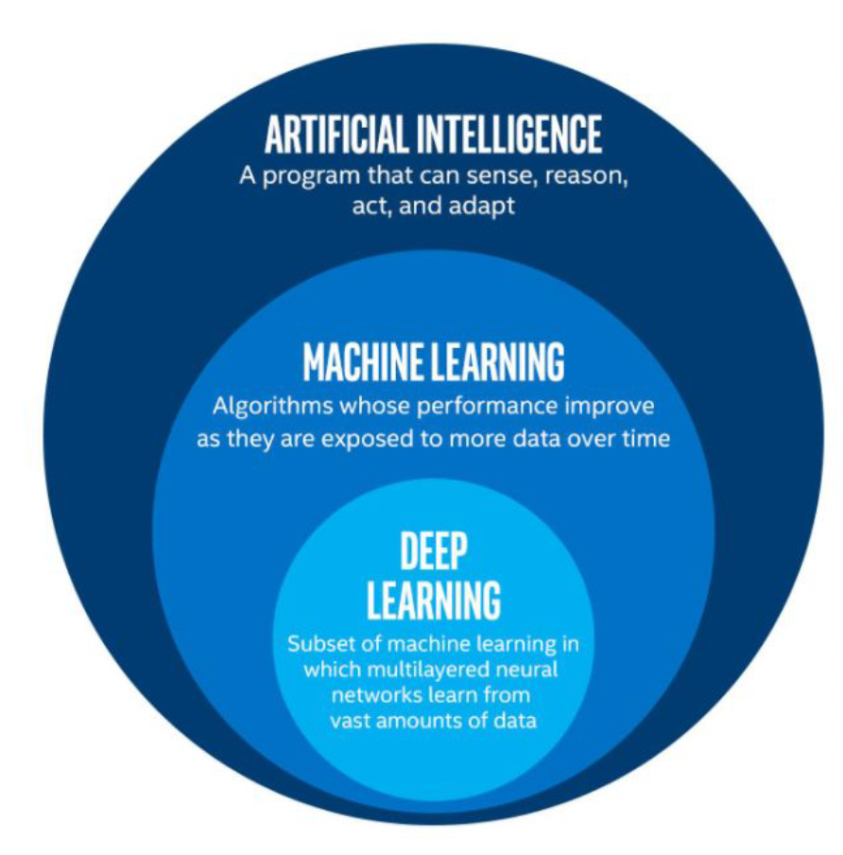
Introduction to Deep Learning
Deep Learning: subfield of traditional machine learning
Inspired by the structure and function of the brain: Artificial Neural Networks
Computer vision: Tesla recognizing items on a street
Text Generation: An algorithm trained to create a new Shakespeare piece
Speech recognition
Computer Games: AlphaGo

Slide 4
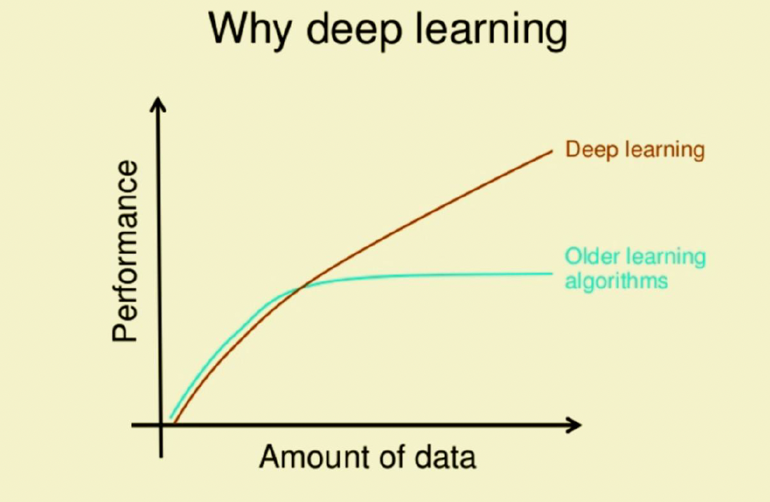
Introduction to Deep Learning
What drives the recent development of Deep Learning?
Larger amounts of data available
Data Storage
Strong computation units such as GPU’s

Slide 5
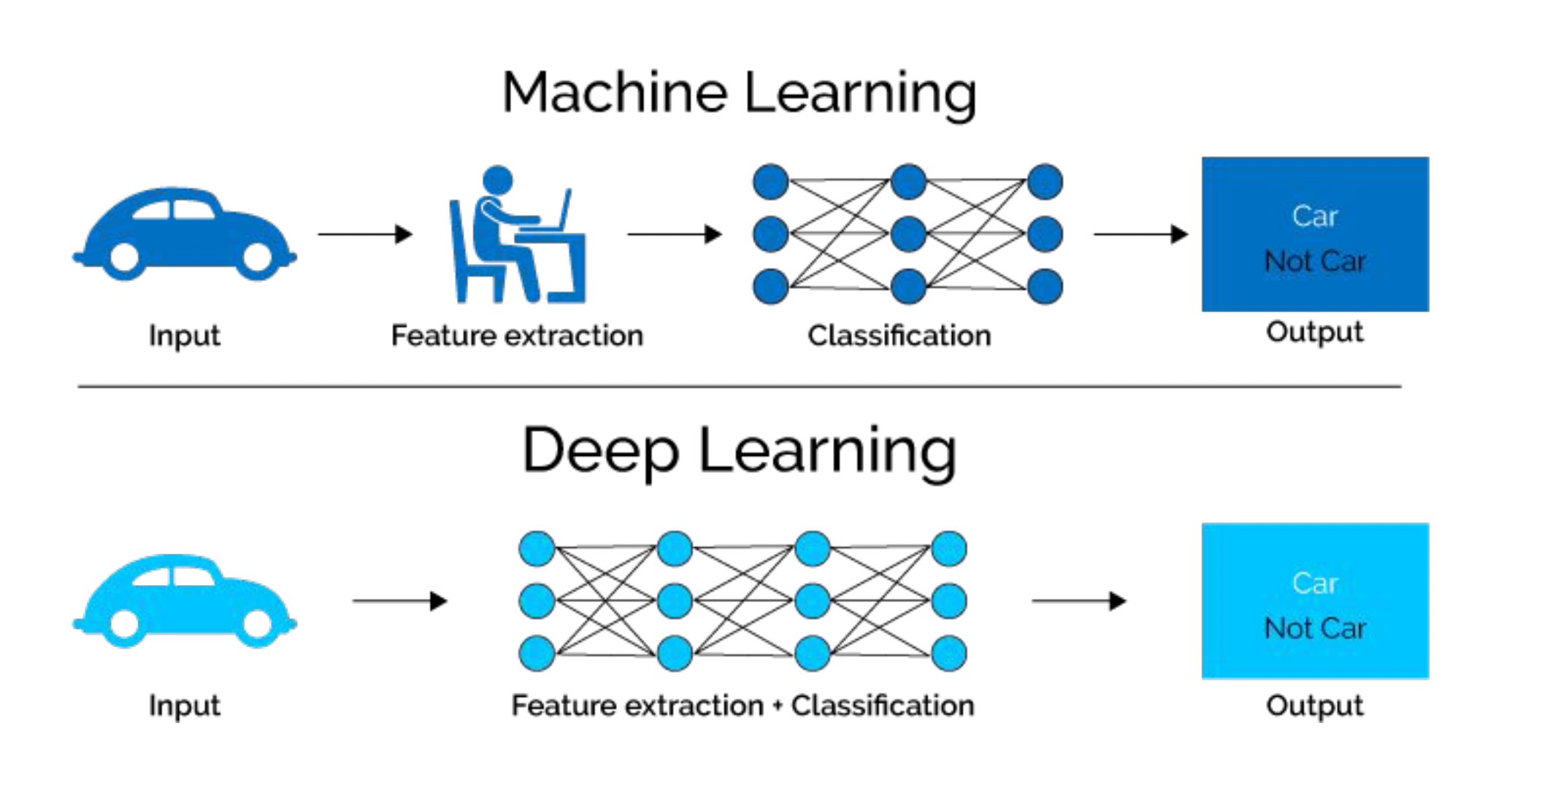
Introduction to Deep Learning

Slide 6
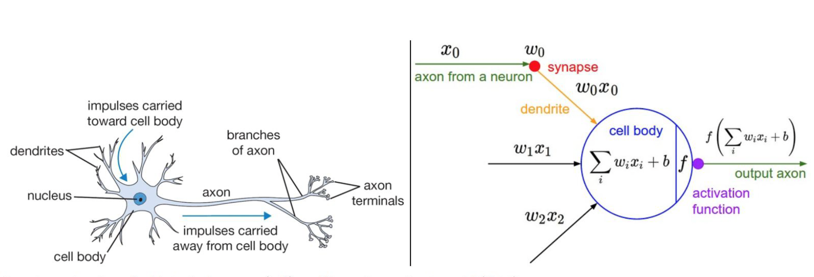
Neural Networks
biological neuron
artificial neural networks

Slide 7
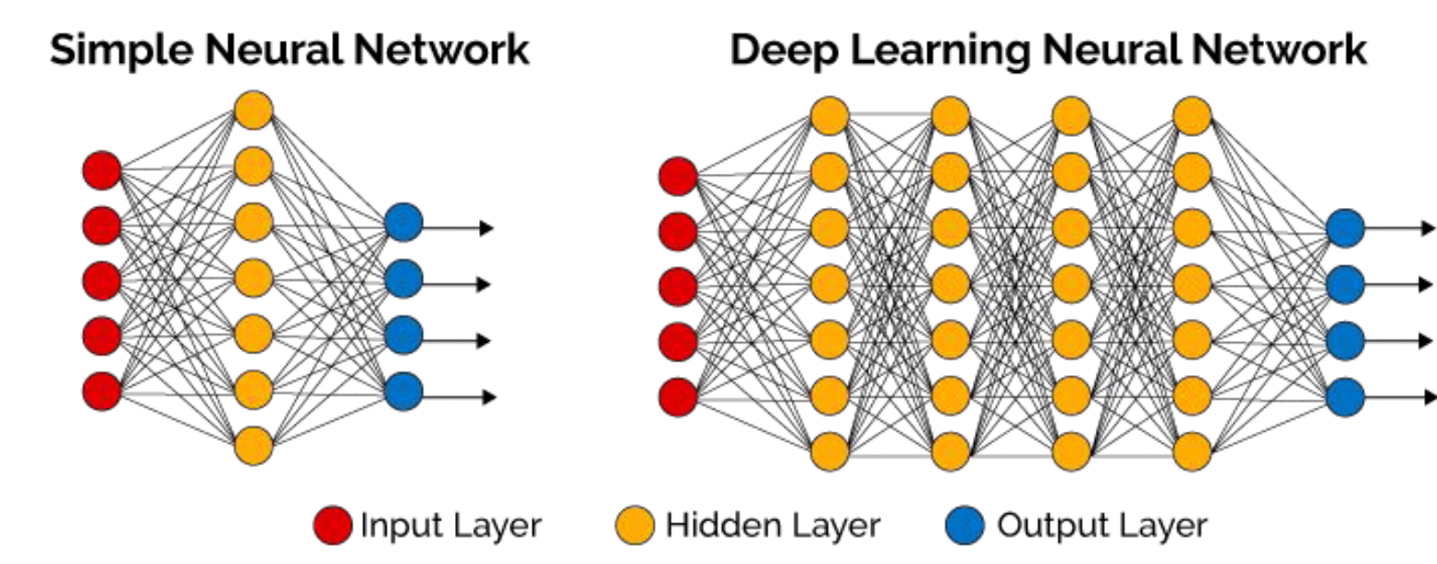
Neural Networks
Deep neural networks (DNN) usually has more hidden layers
Still has same 3 types of layers
A neural network (NN) has 3 types of layers:
Input layer Hidden layer Output layer

Slide 8
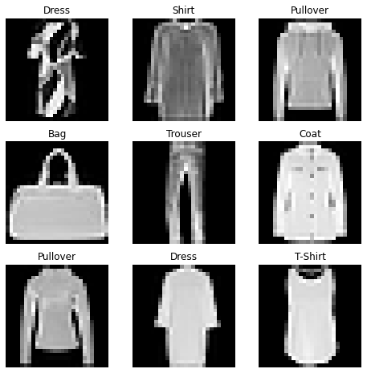
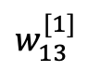
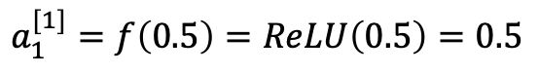
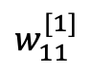
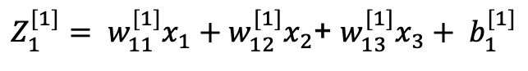
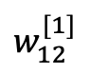
Neural Networks
0.5
$$w_{11}^{[1]}$$
0.4
$$w_{12}^{[1]}$$
$Z_{1}^{[1]}= w_{11}^{[1]}x_{1}+w_{12}^{[1]}x_{2}$+ $w_{13}^{[1]}x_{3}+ b_{1}^{[1]}$
0.2
$$w_{13}^{[1]}$$
$=0.5 ∗0.4+0.1 ∗0.2+0.8 ∗0.1+0.2=0.5$
$$a_{1}^{[1]}=f\left(0.5\right)=ReLU\left(0.5\right)=0.5$$
0.1
Weights are initialized randomly
28 * 28 = 784
A_1

Slide 9
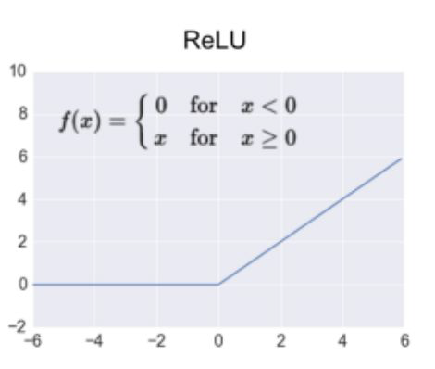
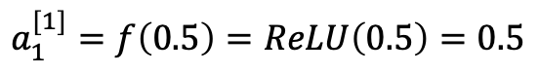
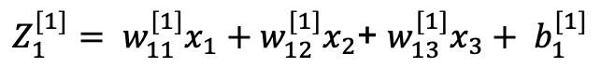
Neural Networks
$Z_{1}^{[1]}= w_{11}^{[1]}x_{1}+w_{12}^{[1]}x_{2}$+ $w_{13}^{[1]}x_{3}+ b_{1}^{[1]}$
$=0.5 ∗0.4+0.1 ∗0.2+0.8 ∗0.1+0.2=0.5$
$$a_{1}^{[1]}=f\left(0.5\right)=ReLU\left(0.5\right)=0.5$$

Slide 10
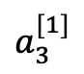
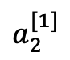
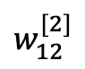
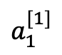
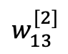
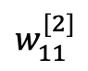
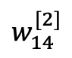
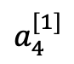
Neural Networks
$$a_{1}^{[1]}$$
0.5
$$w_{11}^{[2]}$$
0.4
$$a_{2}^{[1]}$$
0.89
0.2
$$w_{12}^{[2]}$$
0.2
2
$$a_{3}^{[1]}$$
$$w_{13}^{[2]}$$
0.3
3
$Z_{1}^{[2]}= w_{11}^{[2]}a_{1}^{[1]}+w_{12}^{[2]}a_{2}^{[1]}$+ $w_{13}^{[2]}a_{3}^{[1]}+w_{14}^{[2]}a_{4}^{[1]}+b_{1}^{[2]}$
0.1
$$w_{14}^{[2]}$$
$=0.3 ∗0.5+0.1 ∗0.2+0.2 ∗0.3+0.4 ∗0.9+ 0.3$
$$a_{4}^{[1]}$$
$=0.89$
0.9
$$a_{1}^{[2]}=f\left(Z_{1}^{[2]}\right)=f\left(0.89\right)=ReLU\left(0.89\right)=0.89$$
A_1

Slide 11
Neural Networks
Three steps to training a neural network
1 Forward propagation: push example through the network to get a predicted output
2 Compute the cost: calculate the difference between predicted output and actual data
3 Backward propagation: push back the derivative of the error and apply to each weight, such that next time it will result in a lower error

Slide 12
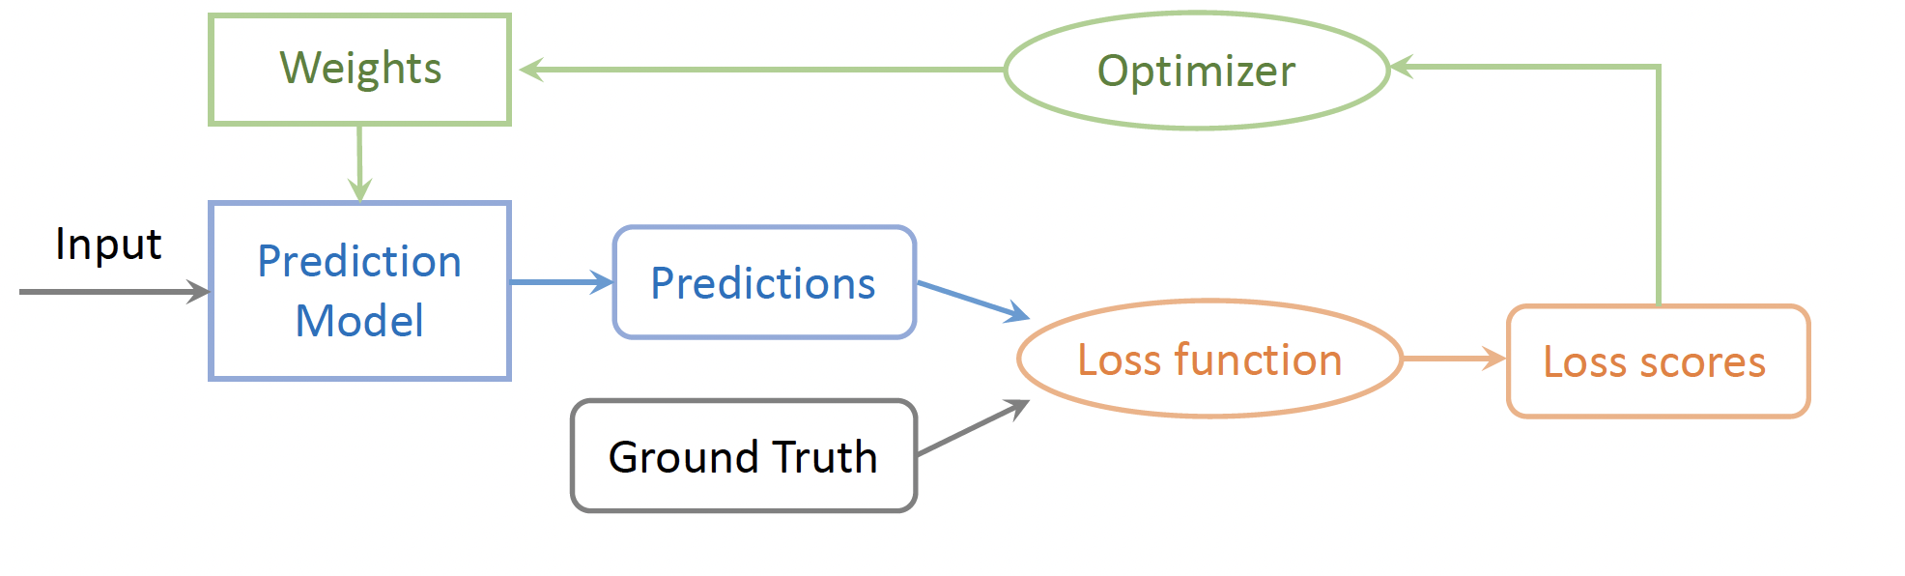
Neural Networks
The training pipeline consists of choosing the prediction model, the loss function and the optimizer.
Once these choices are made, we can feed the input data and labels to start the training process.

Slide 13
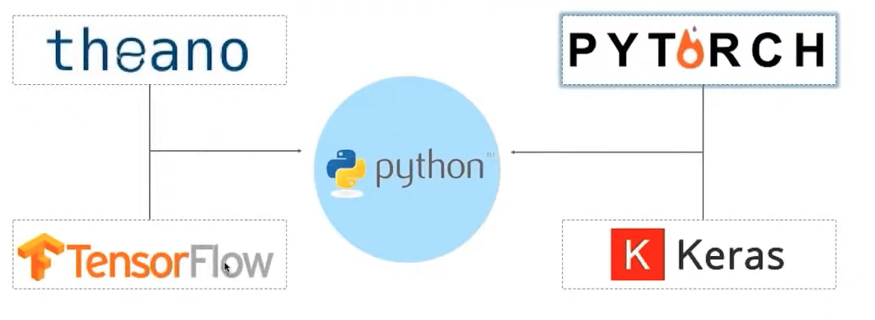
PyTorch Example

Slide 14
PyTorch Example
Tensors are a specialized data structure similar to arrays and matrices
PyTorch uses tensors to encode the inputs and outputs of a model, as well as model’s parameters
Can run on GPUs or other hardware accelerators
Optimized for automatic differentiation

Slide 15
PyTorch Example
Machine Learning Workflows
Working with data
Creating models
Optimizing model parameters
Saving the trained models

Slide 16
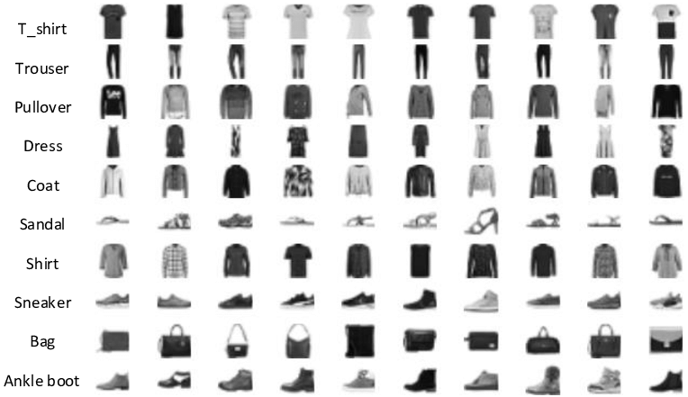
PyTorch Example
Predict if an input image belongs to one of the following classes: T-shirt/top, Trouser, Pullover, Dress, Coat, Sandal, Shirt, Sneaker, Bag, or Angle boot.
FasionMNIST Dataset

Slide 17
PyTorch Example
Let’s build our Conda Environment First:
https://github.com/uschpc/Building-NeuralNetworks.git
Conda Environment
Jupyter Kernel
OpenOnDemand
Jupyter Notebook

Slide 18
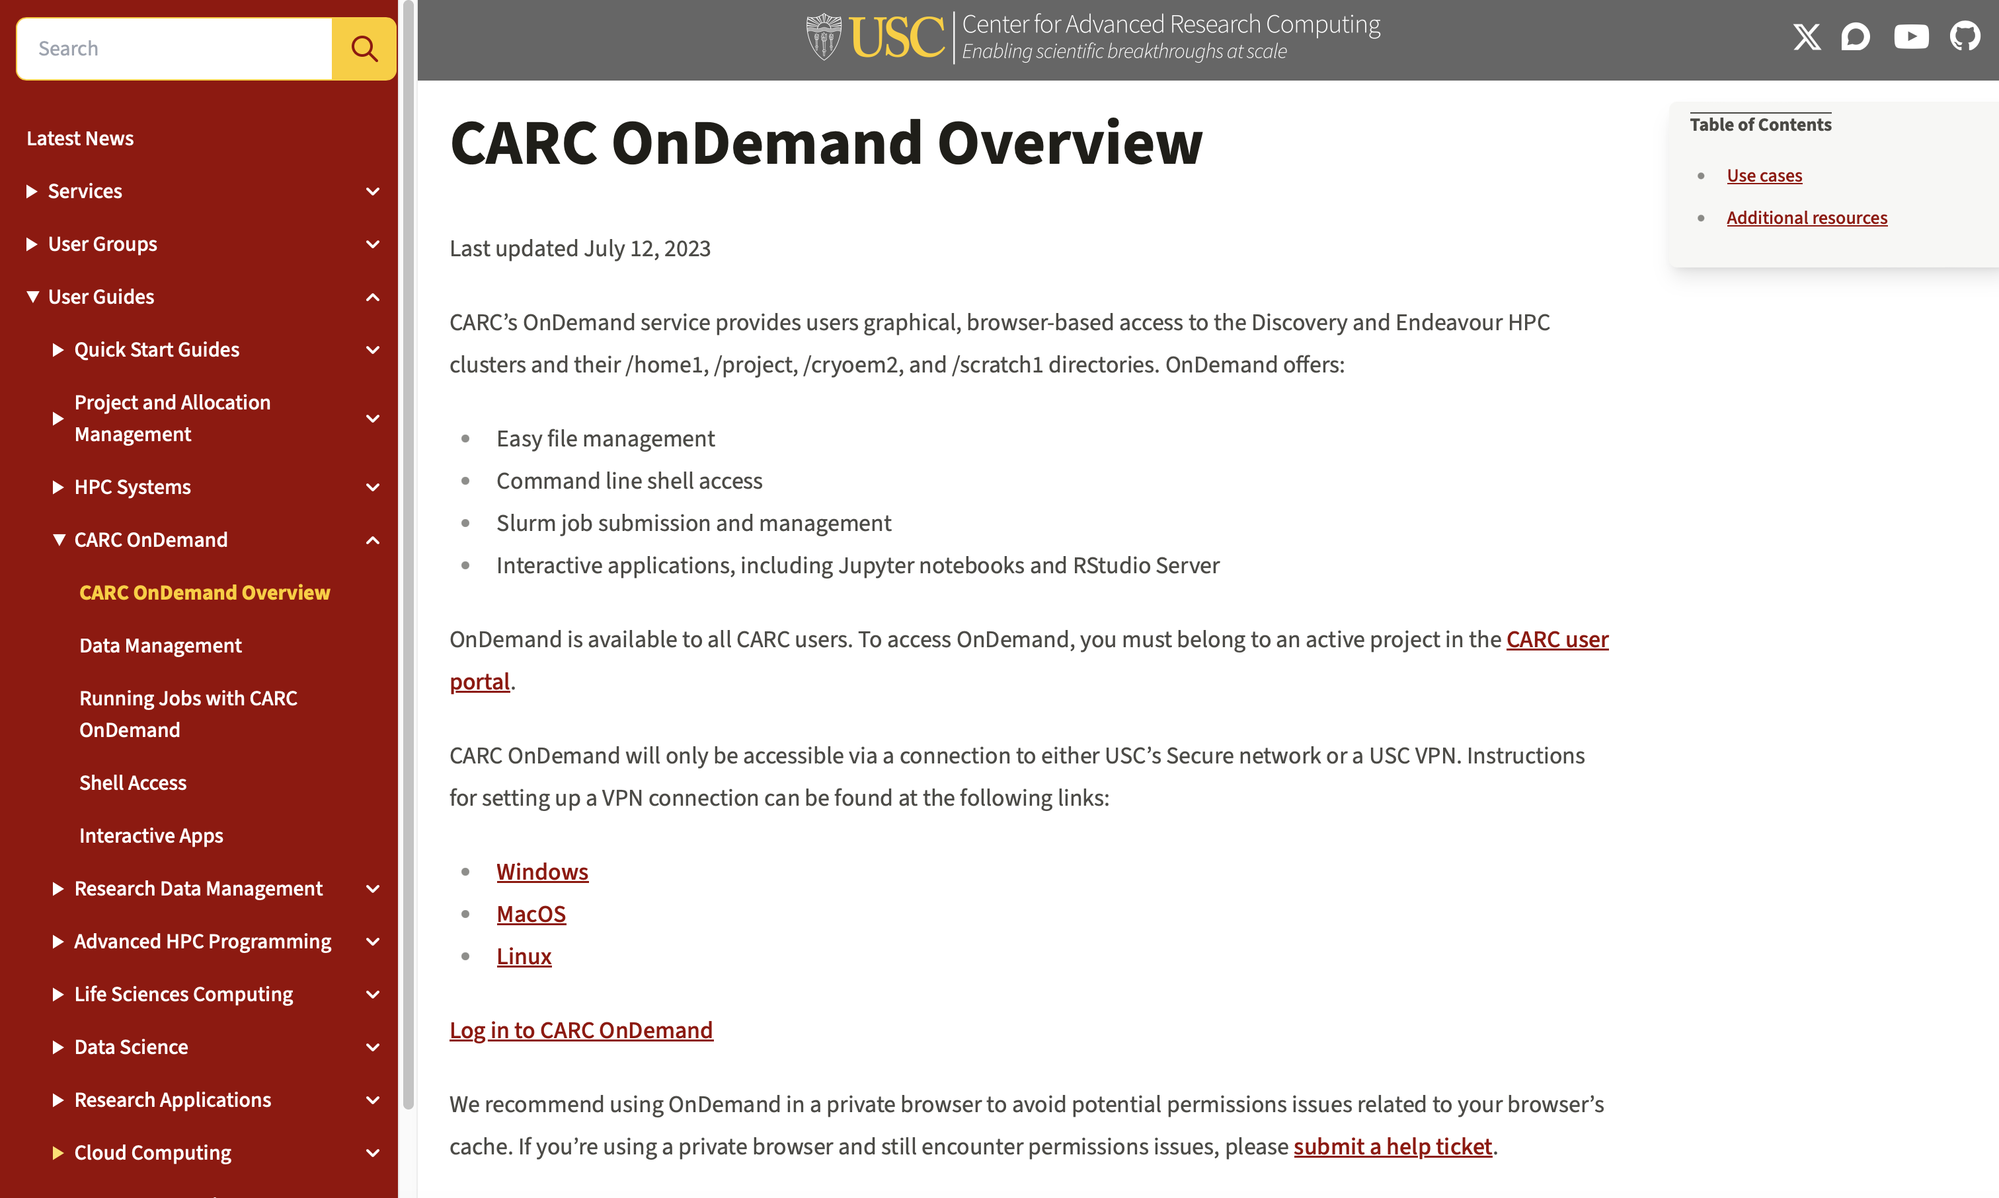

PyTorch Example
https://www.carc.usc.edu

Slide 19
PyTorch Example
Dataset: stores the samples and their corresponding labels TorchText, TorchVision, and TorchAudio
torchvision.datasets: CIFAR, COCO, FashionMNIST
PyTorch
DataLoader: wraps an iterable around the Dataset

Slide 20
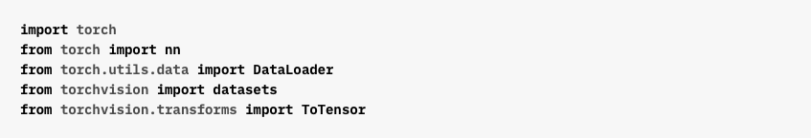
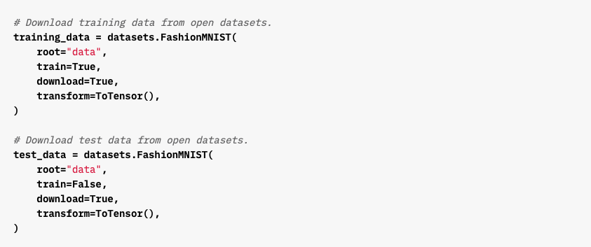
PyTorch Example
Importing Modules
Define Training and Test Dataset

Slide 21
PyTorch Example
Importing Modules
Define Training and Test Dataset

Slide 22
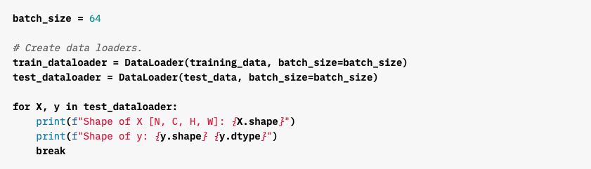
PyTorch Example
Pass the Dataset as an argument to DataLoader
Wraps an iterable over dataset and supports automatic batching, sampling, shuffling and multiprocess data loading
Define DataLoader

Slide 23
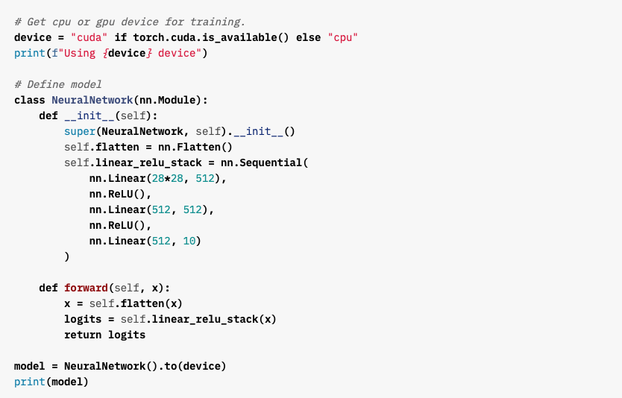
PyTorch Example
Check if GPU is Available
Create Neural Networks Model

Slide 24
PyTorch Example

Slide 25
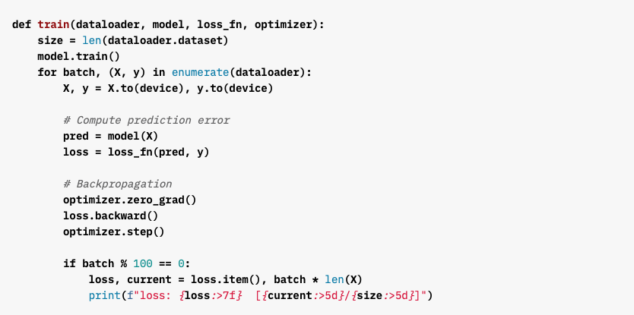
PyTorch Example

Slide 26
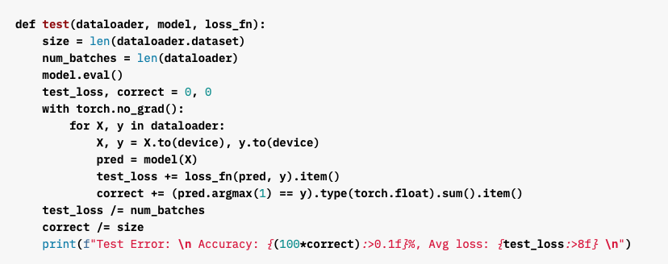
PyTorch Example

Slide 27
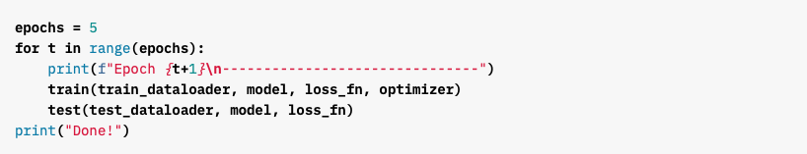
PyTorch Example

Slide 28
PyTorch Example

Slide 29
PyTorch Example

Slide 30
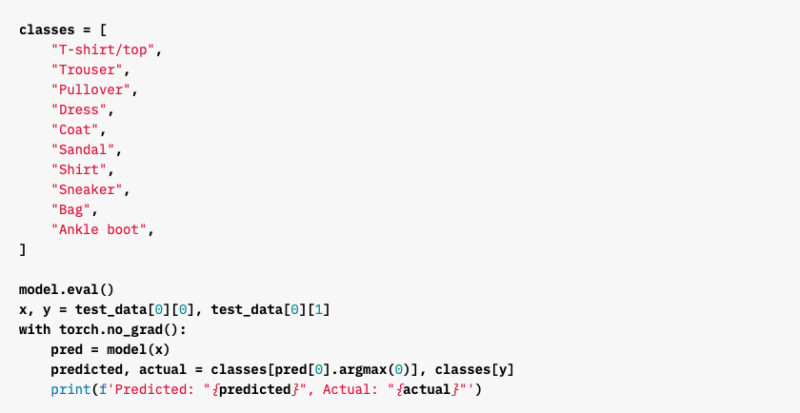
PyTorch Example

Slide 31
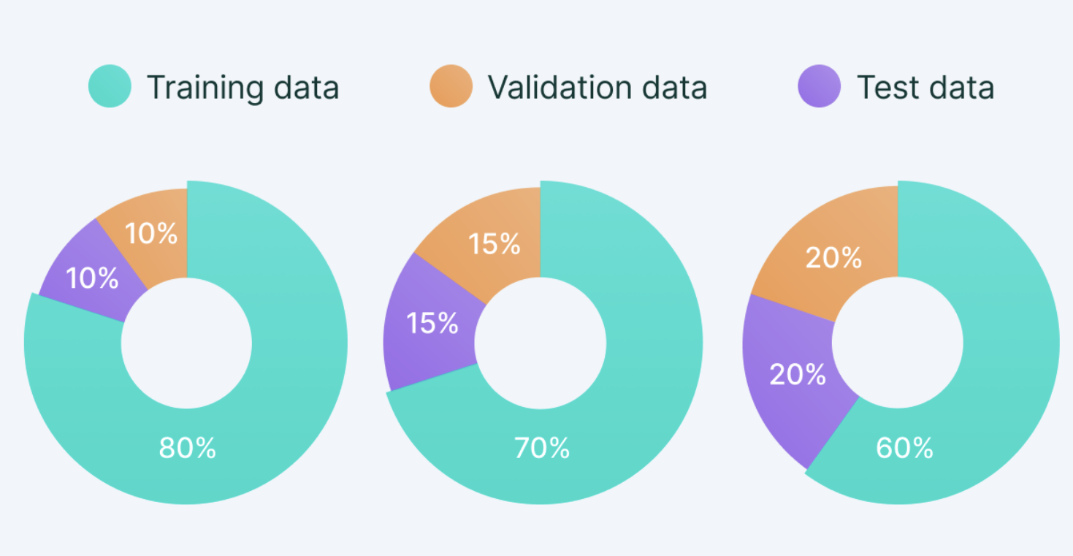
Model Evaluation
Training Dataset: The sample of data used to fit the model.
Validation Dataset: The sample of data used to provide an evaluation of a model fit on the training dataset while tuning model hyperparameters.
Test Dataset: The sample of data used to provide an unbiased evaluation of a final model fit on the training dataset.

Slide 32
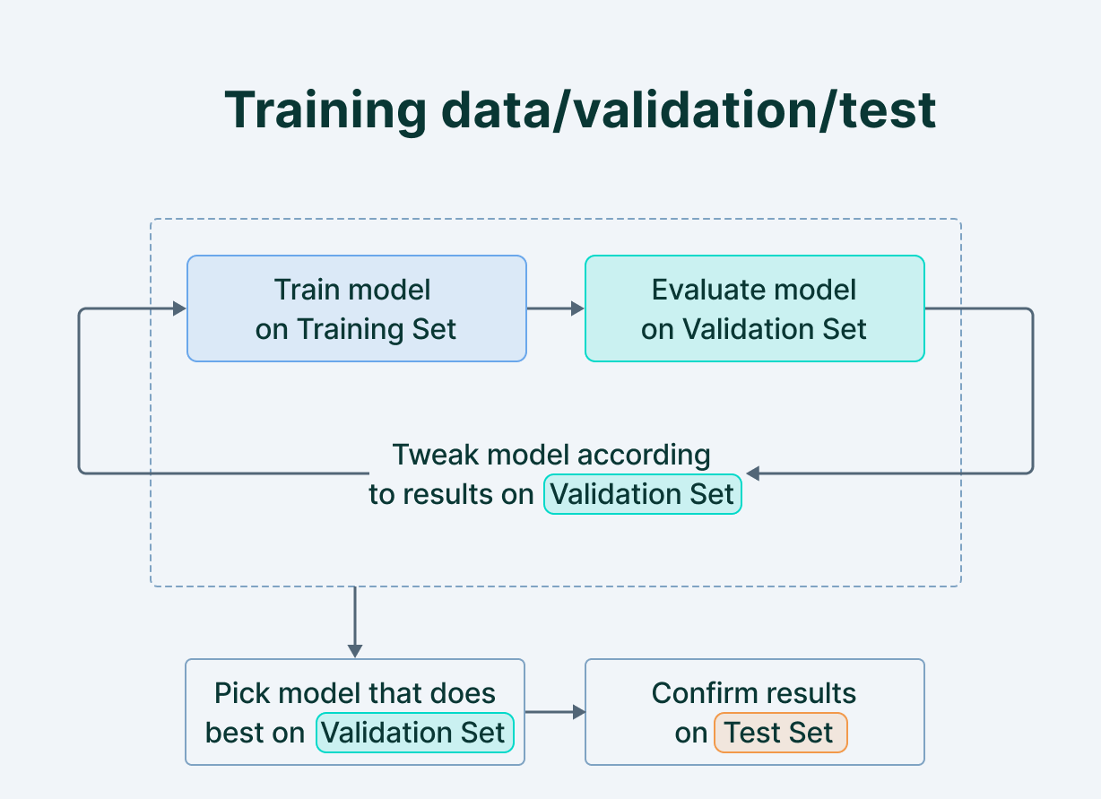
Model Evaluation

Slide 33
Model Evaluation
Underfitting: Underfitting refers to a model that has not adequately learned the training dataset to obtain a sufficiently low training error value.
Overfitting refers to a model that has learned the training dataset too well, including the statistical noise or random fluctuations in the training dataset.
An optimal fit is the goal of the learning algorithm. The loss of the model will almost always be lower on the training dataset than the validation dataset. This means that we should expect some gap between the train and validation loss learning curves. This gap is referred to as the generalization gap.

Slide 34
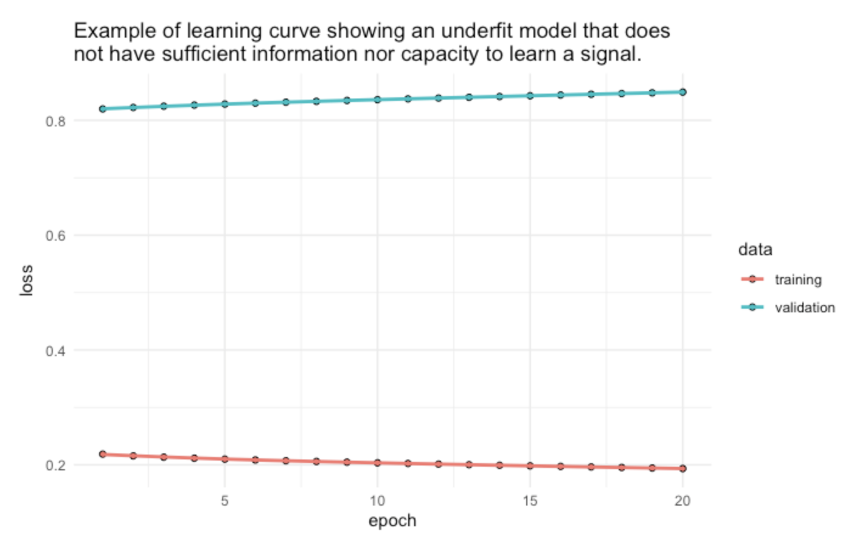
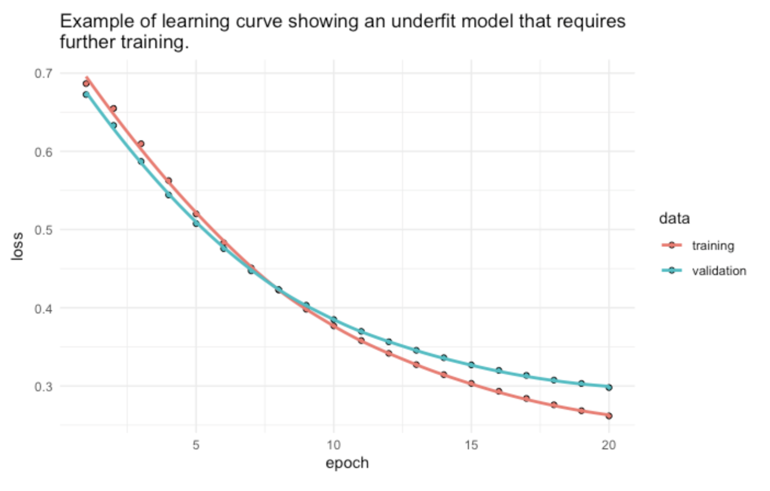
Model Evaluation
Underfitting: Underfitting refers to a model that has not adequately learned the training dataset to obtain a sufficiently low training error value.

Slide 35
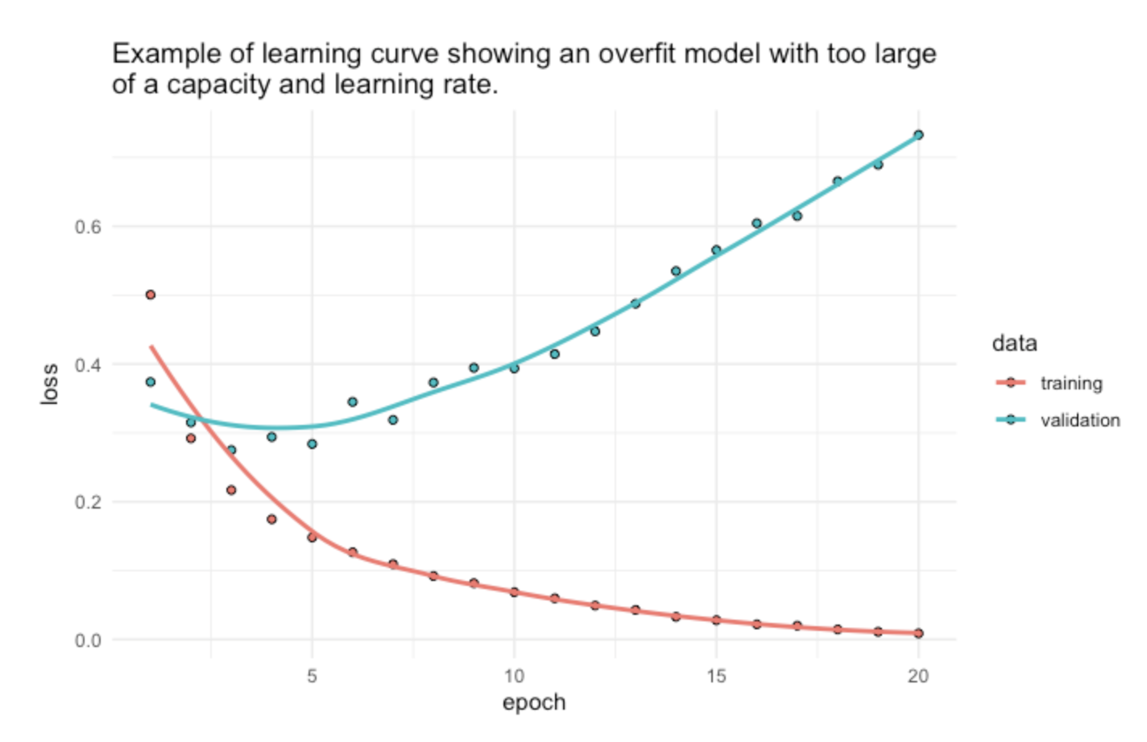
Model Evaluation
Overfitting refers to a model that has learned the training dataset too well, including the statistical noise or random fluctuations in the training dataset.

Slide 36
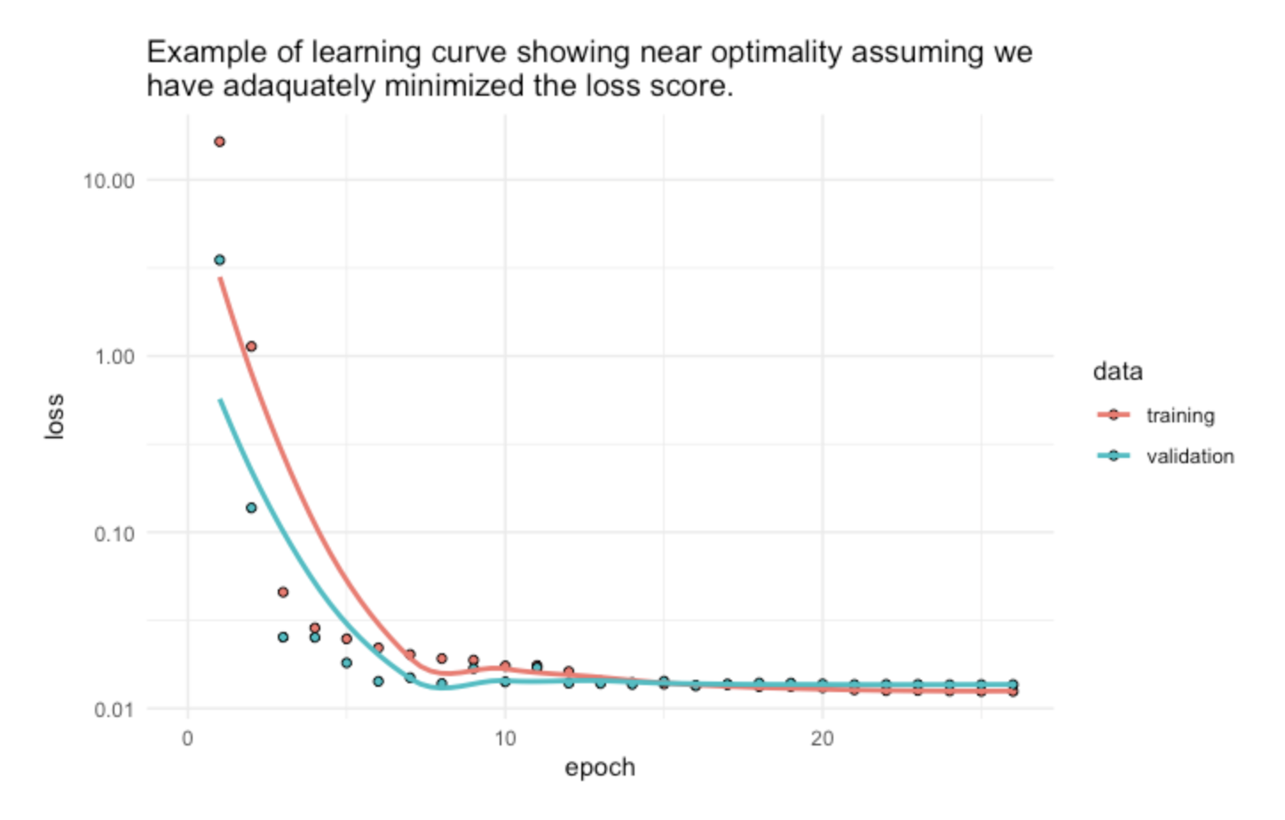
Model Evaluation
An optimal fit is the goal of the learning algorithm. The loss of the model will almost always be lower on the training dataset than the validation dataset. This means that we should expect some gap between the train and validation loss learning curves. This gap is referred to as the generalization gap.
An optimal fit is one where:
The plot of training loss decreases to a point of stability.
The plot of validation loss decreases to a point of stability.
The generalization gap is minimal (nearly zero in an ideal situation).

Slide 37
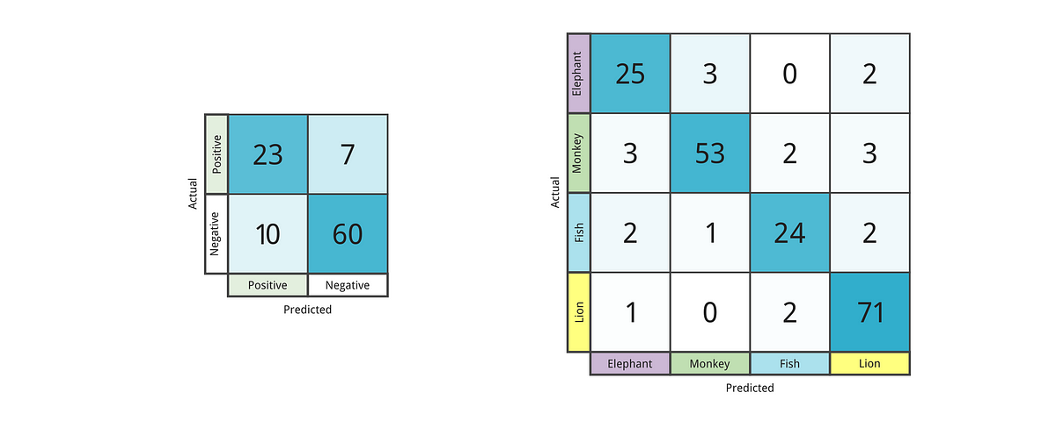
Confusion Matrix
A binary classification problem for a medical test to diagnose a certain disease. The goal of the machine learning model is to predict whether a patient has the disease (positive class) or does not have the disease (negative class). We have the following confusion matrix based on the model's predictions and actual labels:
 | Predicted Positive | Predicted Negative
Actual Positive | 23 | 7
Actual Negative | 10 | 60

Slide 38
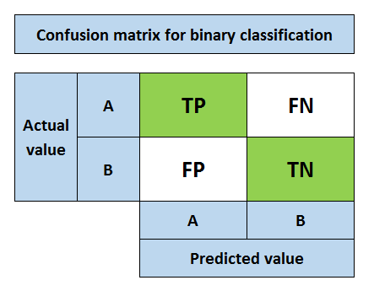
Confusion Matrix

Slide 39
Confusion Matrix
More than two categories

Slide 40
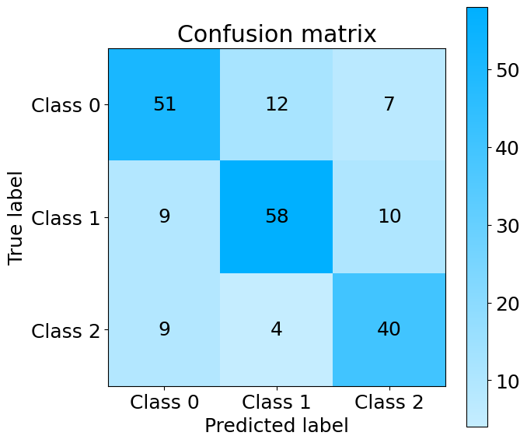
Confusion Matrix
Confusion Matrix Plot by Scikit-learn

Slide 41
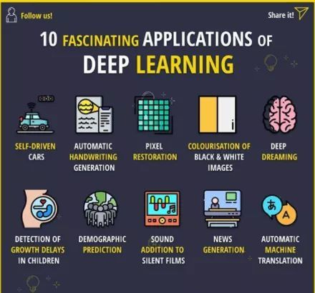
Applications
Deep Learning Applications

